Slide 1
CSPC Co-Treasurer’s Report
Jan 23, 2025

Slide 2
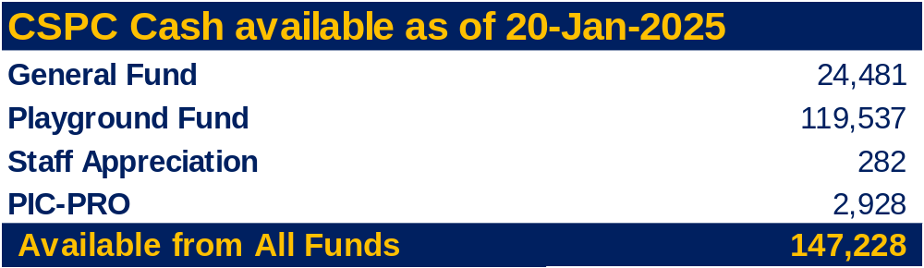
Summary of Current CSPC Funds
General fund includes Scotia balance (adjusted, after cheques written but not yet cashed are cleared.
Playground fund includes funds raised by parents as well as $41,062 from successful grants (held at Board)
$78,475 cheque was delivered to the Board on Jan 15/25 (funds will be transferred to Board account for playground improvement project this summer)

Slide 3
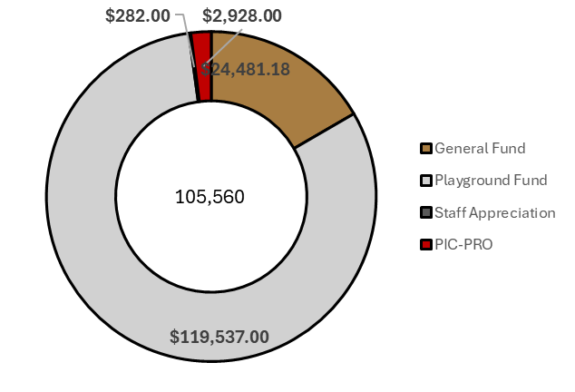
Summary of Current CSPC Funds

Slide 4
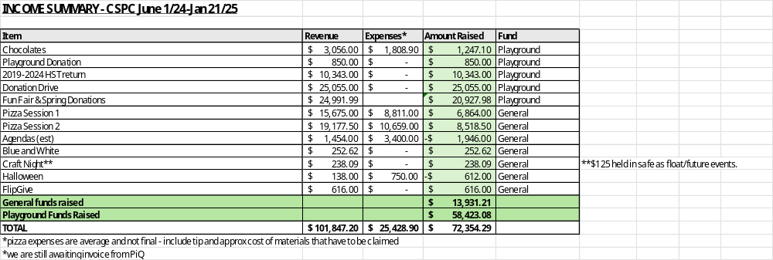

Note for future that the General fund is currently buoyed by carryover from previous years (we will spend up to $20k more than raised this year)
With less of a focus on playground this may not be a big deal but needs to be kept in mind ahead of next year.

Slide 5
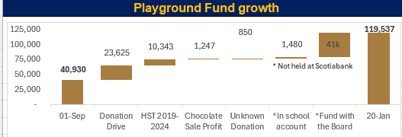
Playground Fund

Slide 6
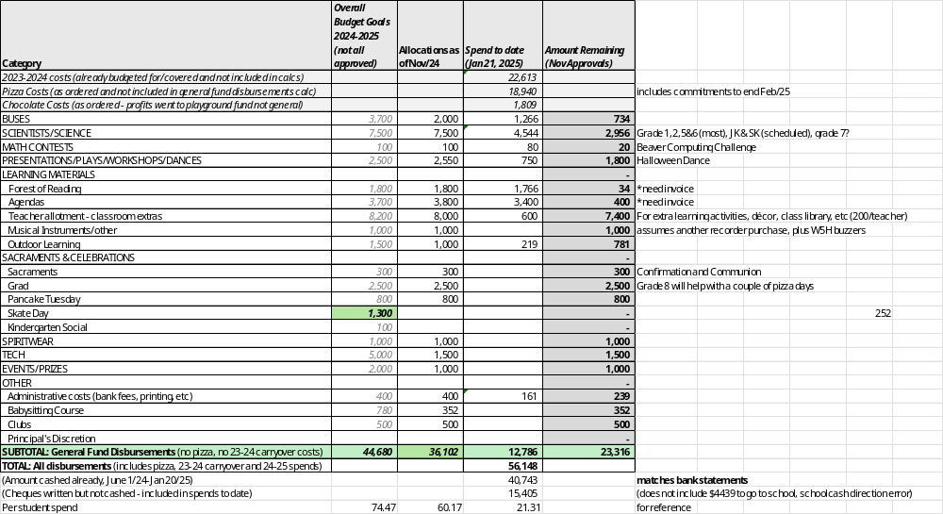
2024-2025 CSPC Budget (General Fund) - $1165.18 currently unallocated (expecting more from session 3 pizza)

Slide 7
2024-2025 CSPC Budget (General Fund)
Upshot: tracking as expected
Many scientists booked; some other claims coming in
$1165.18 currently unallocated (expecting more from session 3 pizza)
Motion – skate day buses?
Any other items needed?

Slide 8
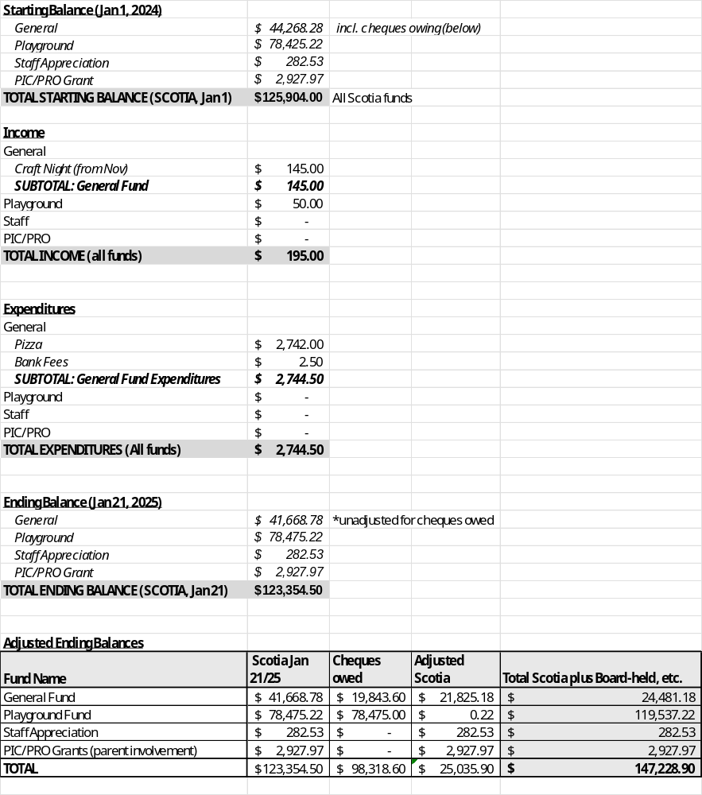
Bank Reconciliations – Available/in Records

Slide 9
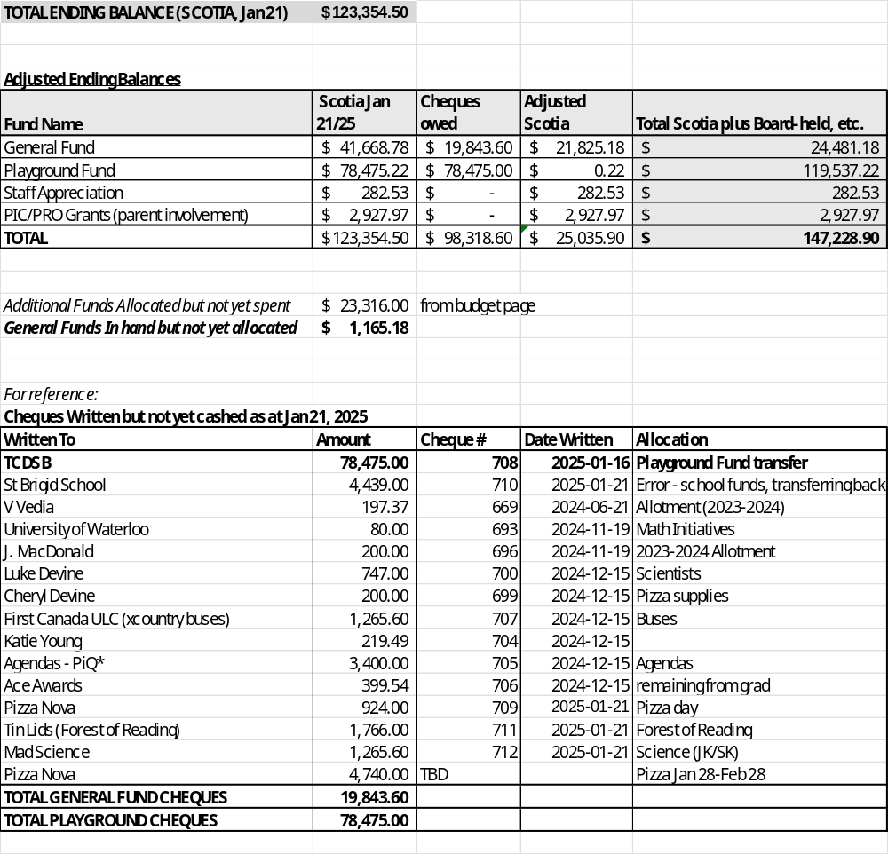
Bank Reconciliations – Available :)

