Slide 1
Playground Update
Meetings held in Nov and Dec 17 – parents as well as Mr. Kerr in attendance
Work is confirmed planned for summer 2025
Cheque for $78,475 dropped off at the Board last Friday
Katie has been in touch with Sahar (Board rep), knows interest in giving feedback before ordering of any items.
Noted to Board that site map as drawn is a little off, trees and parking lot slightly different from drawings

Slide 2
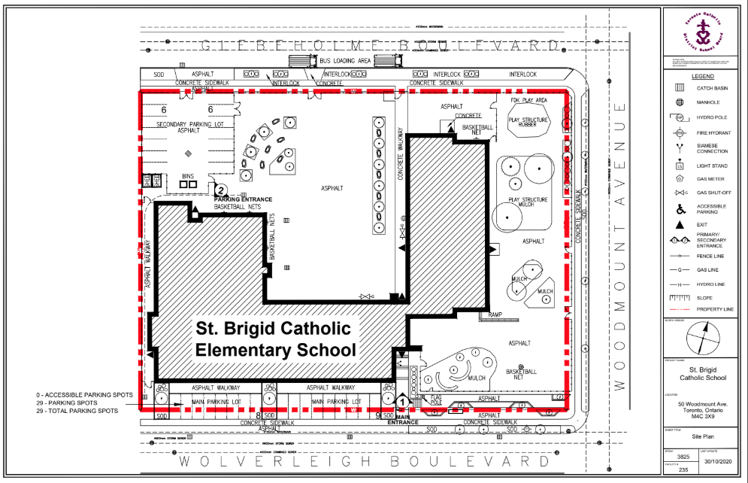
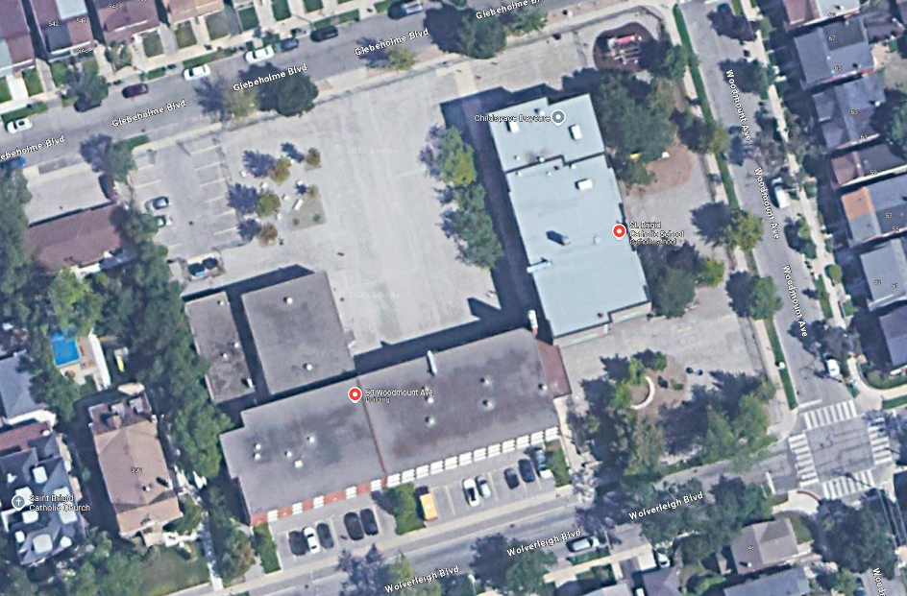

Slide 3
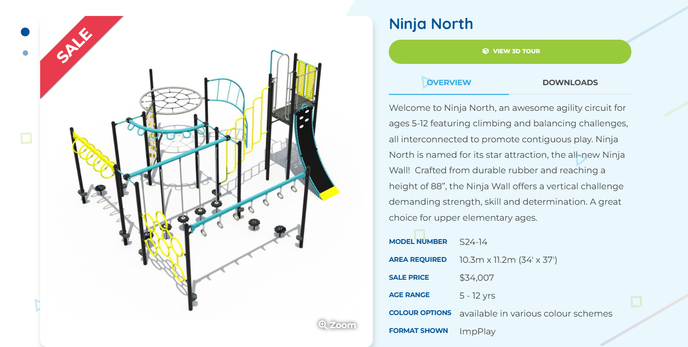
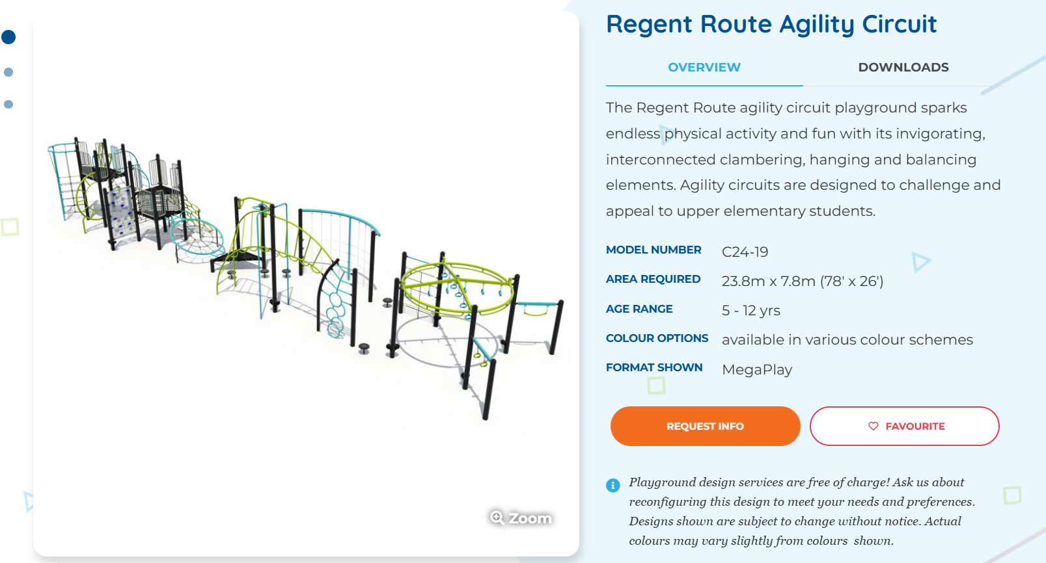
North yard

Slide 4
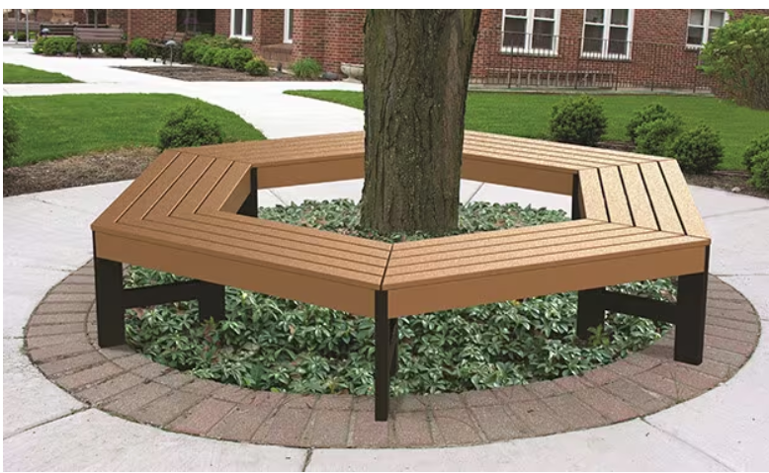
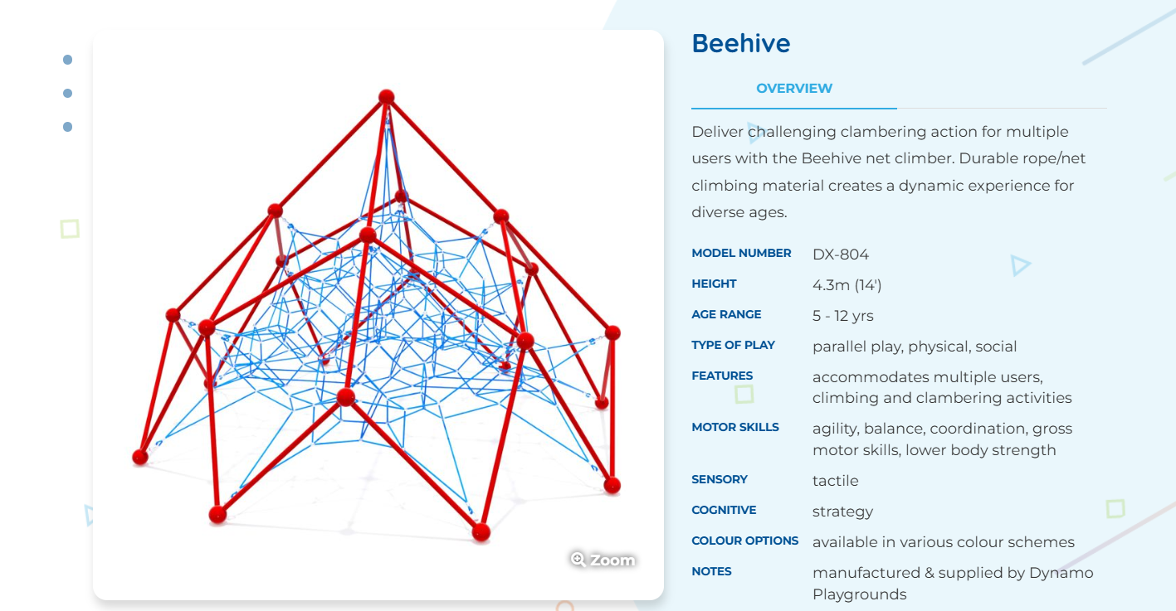
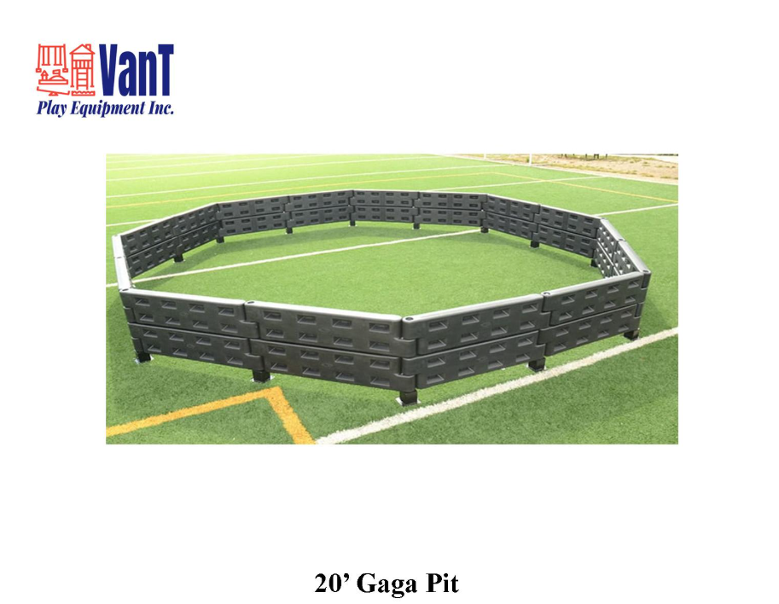
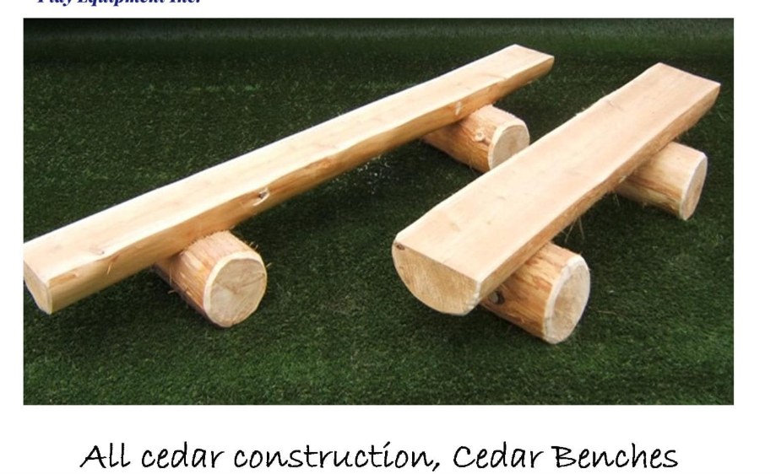
North yard
Green/turf
Garden spot
Strategic fencing

Slide 5
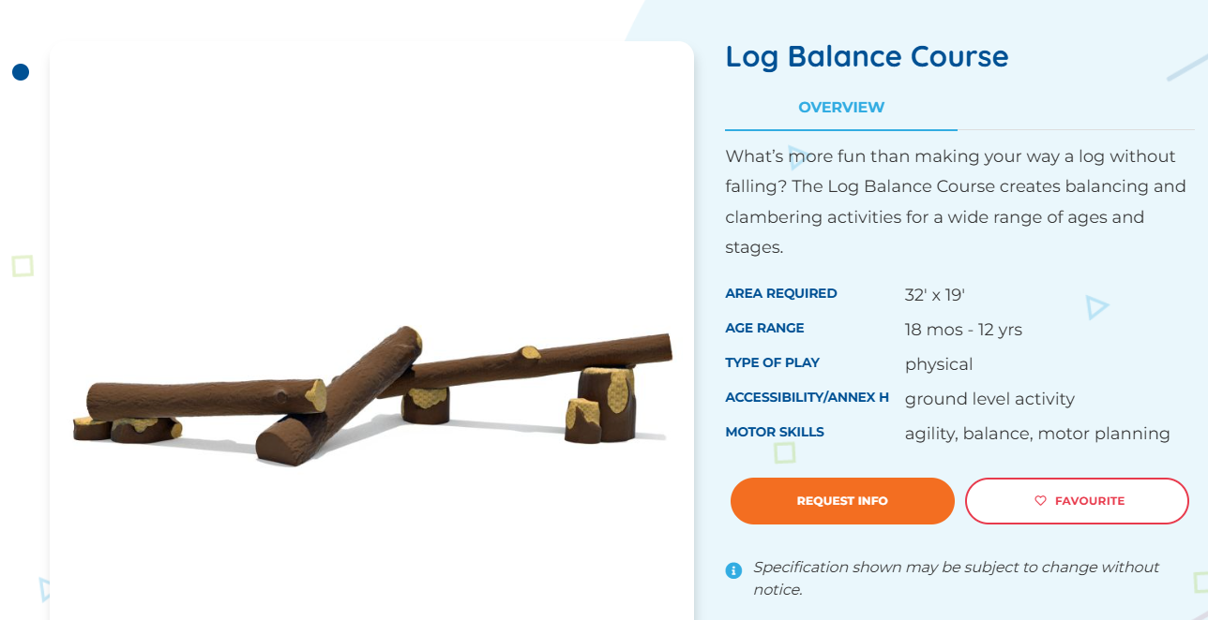
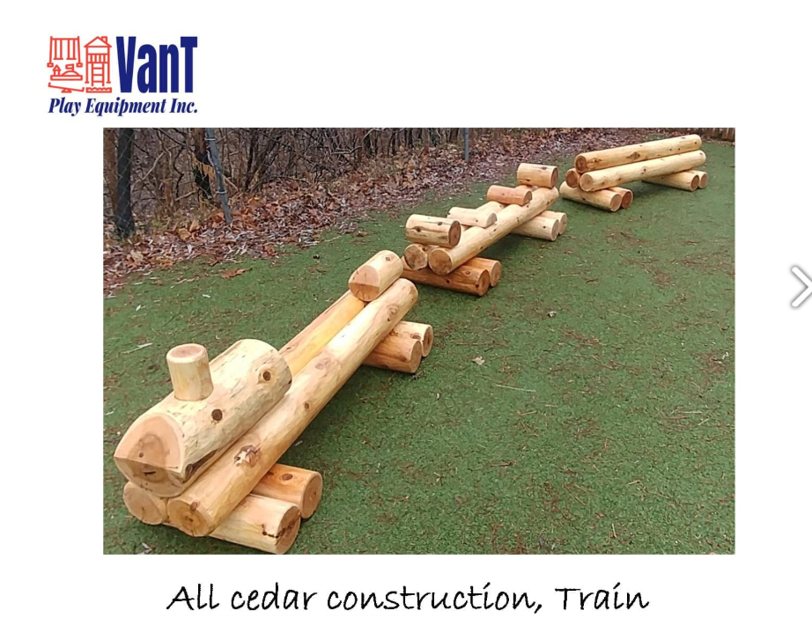
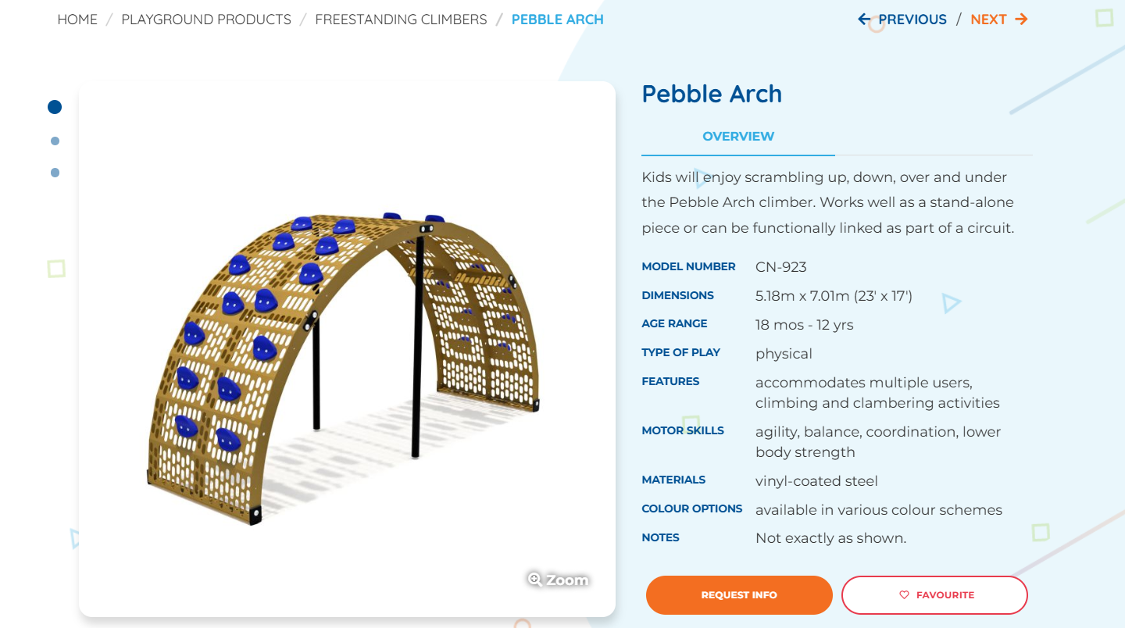
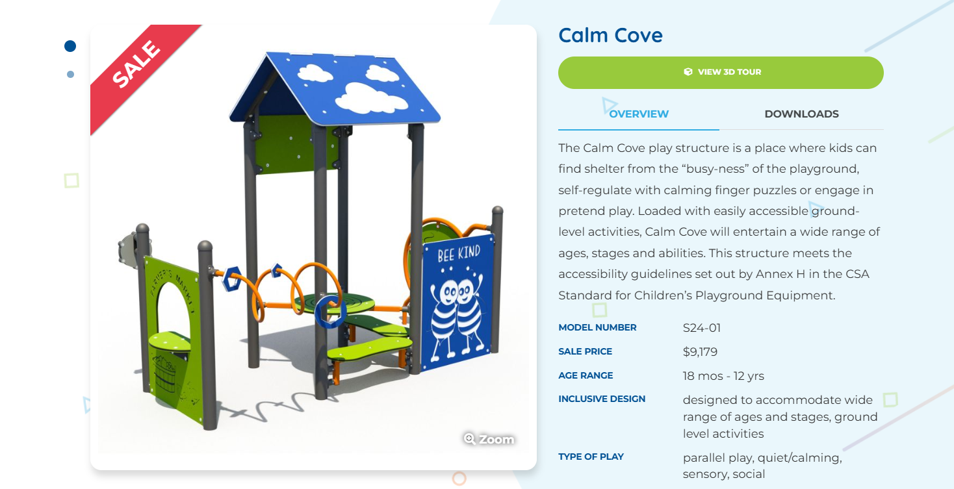
Kinder
Turf ask as well

Slide 6
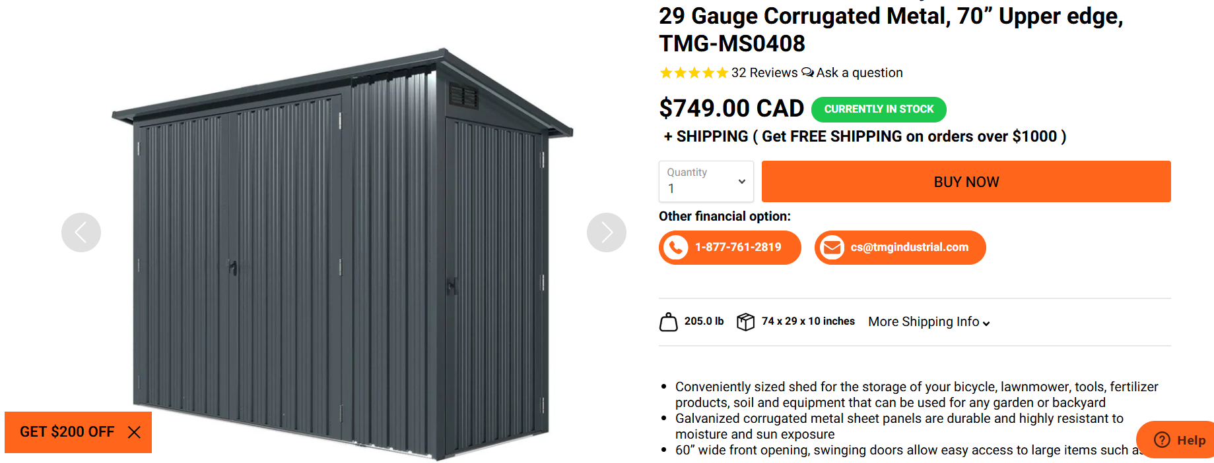
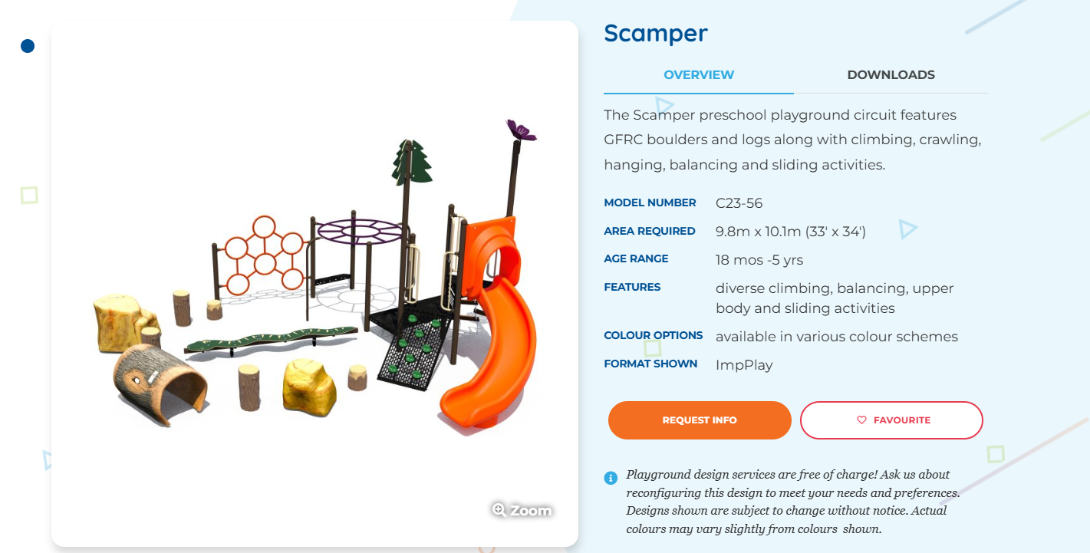
Kinder

